Slide 1
Screen Time to Green Time
By: Ananya Mehta
Grade 7 Non RRI
A34
https://youtu.be/PHMpfXvz8EQ
Notes:
5 seconds (5)

Slide 2
Introduction
Engineering Goal: The design and construction of a desktop application that can process data from a fitness tracker and use it to control access to the WiFi router, to help balance screen time and physical activity.
Based on the recent data from the US 2020 Census Bureau, people spend an average of only 2 hours per week being physically active, which is half of the 4 hours recommended by the CDC. On the other hand, the average American spends over 7 hours on screen daily
A research report by NCHS (National Center for Health Statistics) shows that only 23% of Americans exercise on a daily basis
Current solutions to increase physical activity depend on personal motivation, which is not reliable
Notes:
20 seconds (25)

Slide 3
Success Criteria & Design Constraints
Success Criteria:
Should be able to retrieve the correct steps data for the users at least 90% of the time, with a margin of 2 steps
Should be able to disable the internet access for the correct user at the correct time with 90% accuracy, with a margin of 2 seconds
Should be able to detect additional physical activity and allocate time accordingly at least 90% of the time, with a margin of 2 seconds
Design Constraints:
Cannot work without user wearing Google Fit tracker when exercising
Cannot work if router does not provide an application programming interface (API) to control internet access
Must not exceed 6 weeks to prototype the system
Notes:
20 seconds (25)

Slide 4
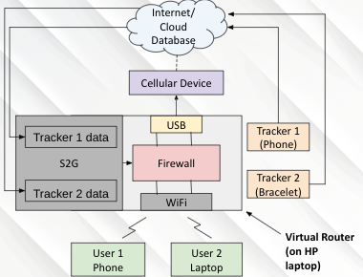
Methods
Test Plan:
Prototype of design:
Virtual router (VR) - Running screen to green (S2G) script, connected to cellular device via USB cable for internet connectivity. Clients (users) connected to Virtual Router via WiFi.
Trackers - Collect fitness data from users, upload to cloud database, from where S2G script fetches data. For testing, replaced bracelet with another phone.
S2G script - Fetches fitness data from cloud database, analyzes fitness data, runs commands to control firewall.
Criteria #1
Record steps using fitness tracker
Fetch data using S2G app on virtual router
Compare and record results
Repeat steps 1-3 five times for the 2 users
Criteria #2
Run S2G app with different amount of steps taken on each tracker
Compare expected time until block (shown on router), and actual time until block (shown on client)
Record results
Repeat steps 1-3 five times for both users
Criteria #3
Run S2G app with different amount of steps taken on each tracker
Compare expected time until unblock (shown on router), and actual time until unblock (shown on client)
Record results
Repeat steps 1-3 five times for both users
Notes:
20 seconds (25)

Slide 5
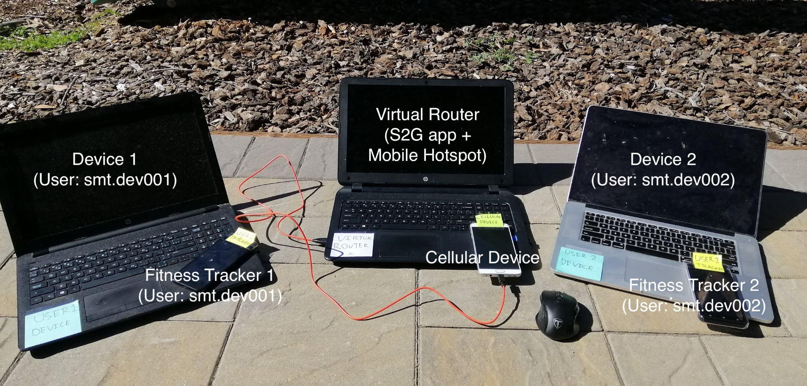
Photo of Prototype
Notes:
20 seconds (25)

Slide 6
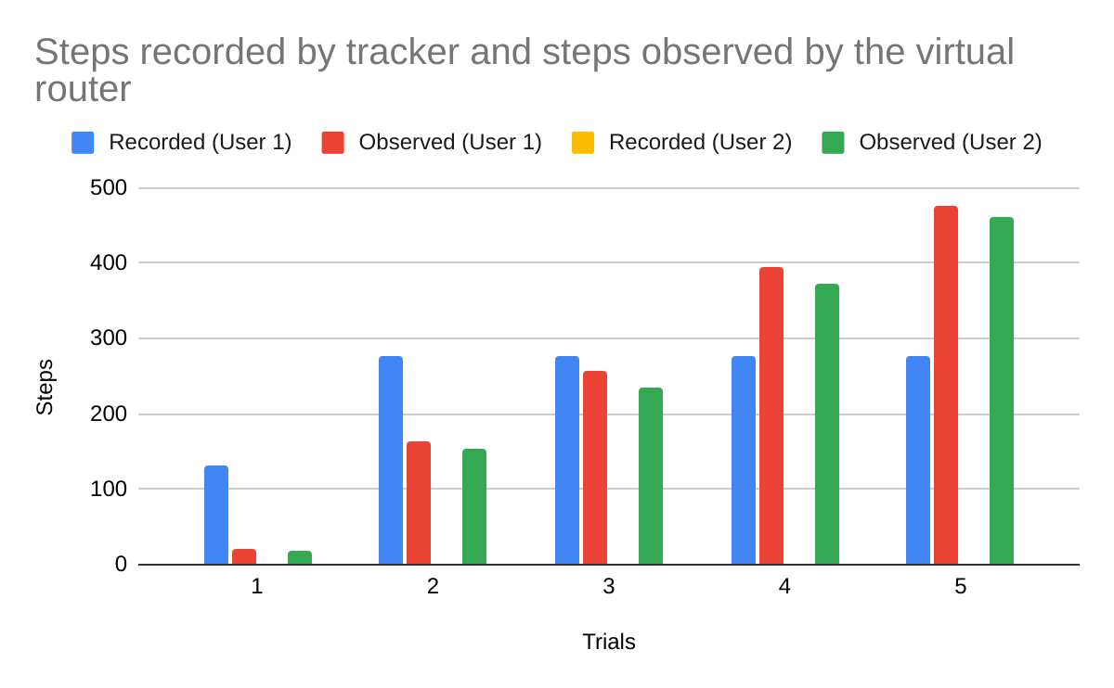
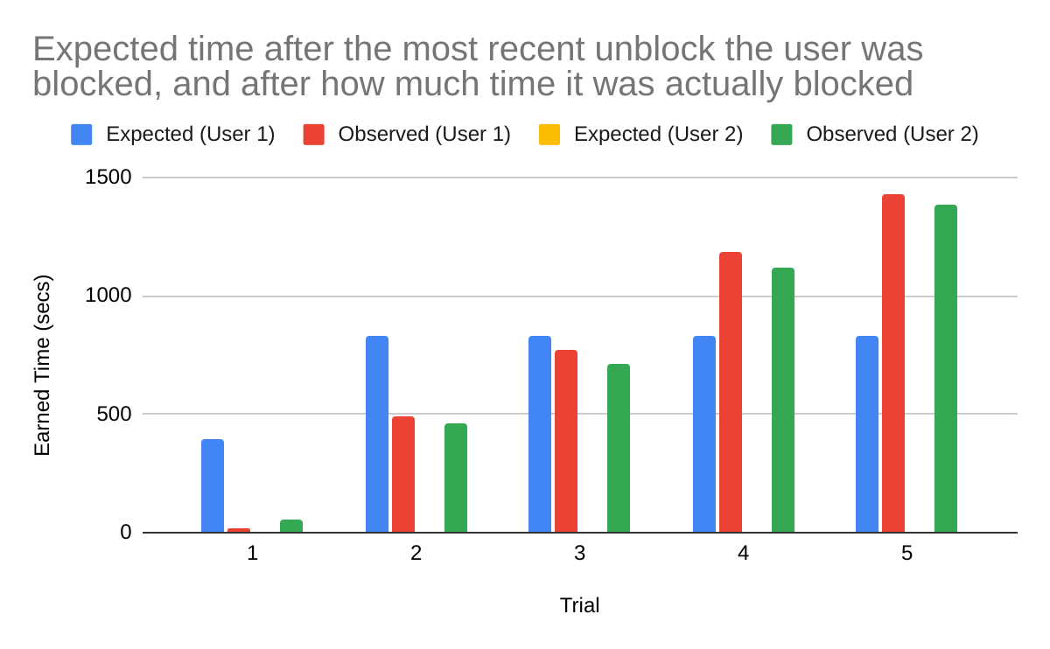
Initial Results
The first round of testing was not successful for any of the success criteria.
Criteria #1 - The steps recorded by the tracker and the steps observed by the virtual router should have been the same, but as shown in the graph, they were not.
Criteria #2 - The expected time until the block and how much time was actually there until the block should have been the same, but as shown in the graph, was not.
Notes:
20 seconds (25)

Slide 7
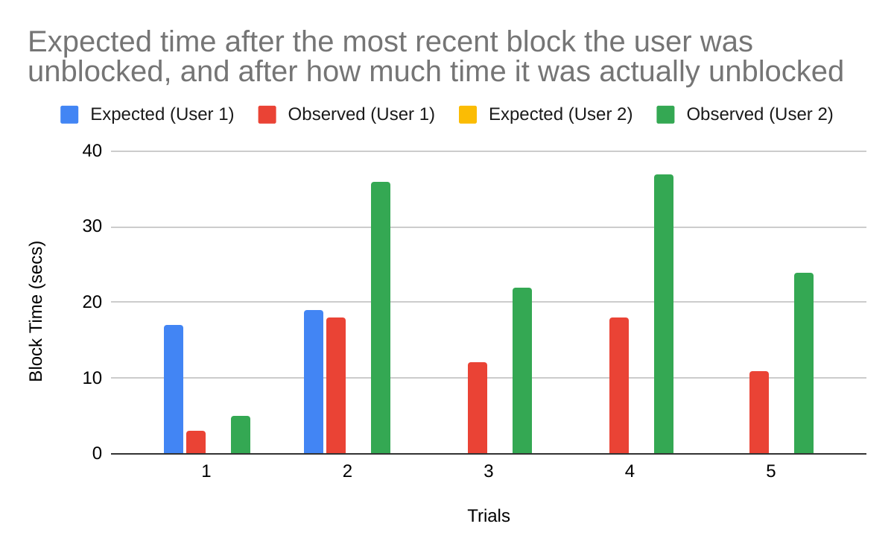
Initial Results
The first round of testing was not successful for any of the success criteria.
Criteria #3 - The expected time until the unblock and how much time was actually there until the unblock should have been the same, but as shown in the graph, was not.
Notes:
20 seconds (25)

Slide 8
Discussion
The initial results were not as expected, and the all of the tests failed.
The issue was caused because the database being used was not being updated fast enough for testing, so the S2G script could not get the correct data in time. By switching to a different database, the problem was resolved.
After retesting with the fixes, all tests were a success 100% of the time.
My prototype is better than existing solutions, since it does not require personal motivation, but instead rewards users with internet connectivity in exchange for physical excersize
Notes:
20 seconds (25)

Slide 9
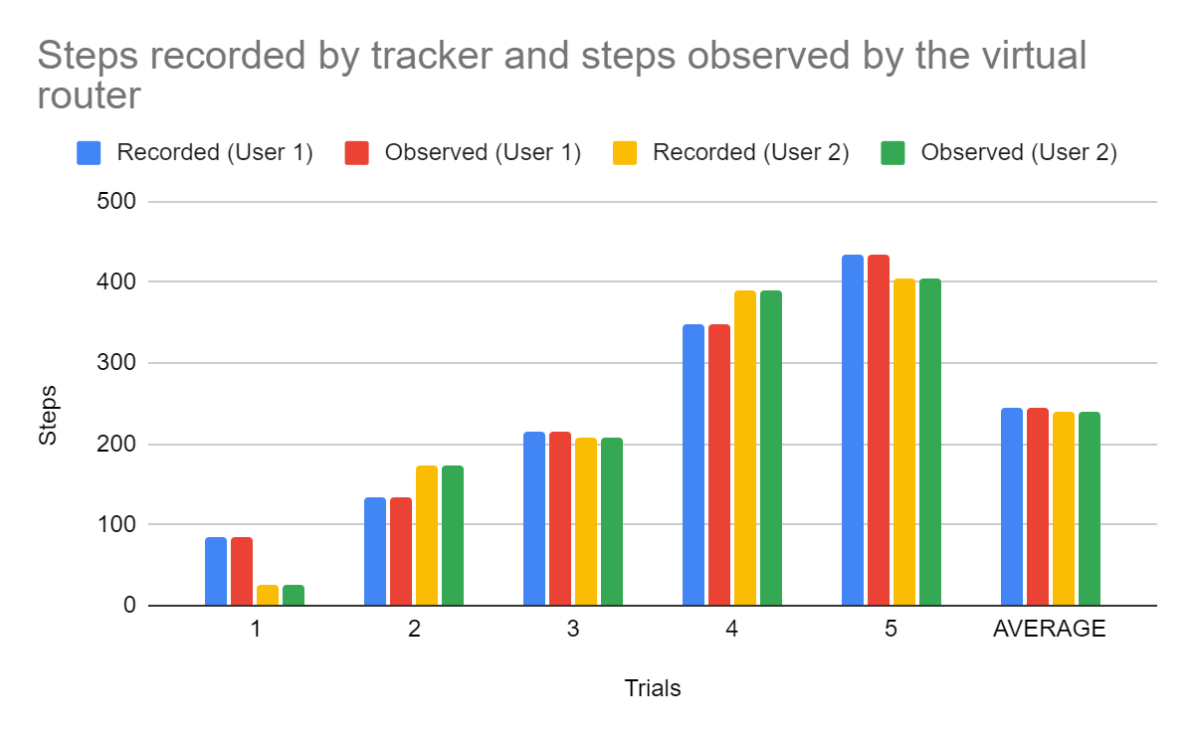
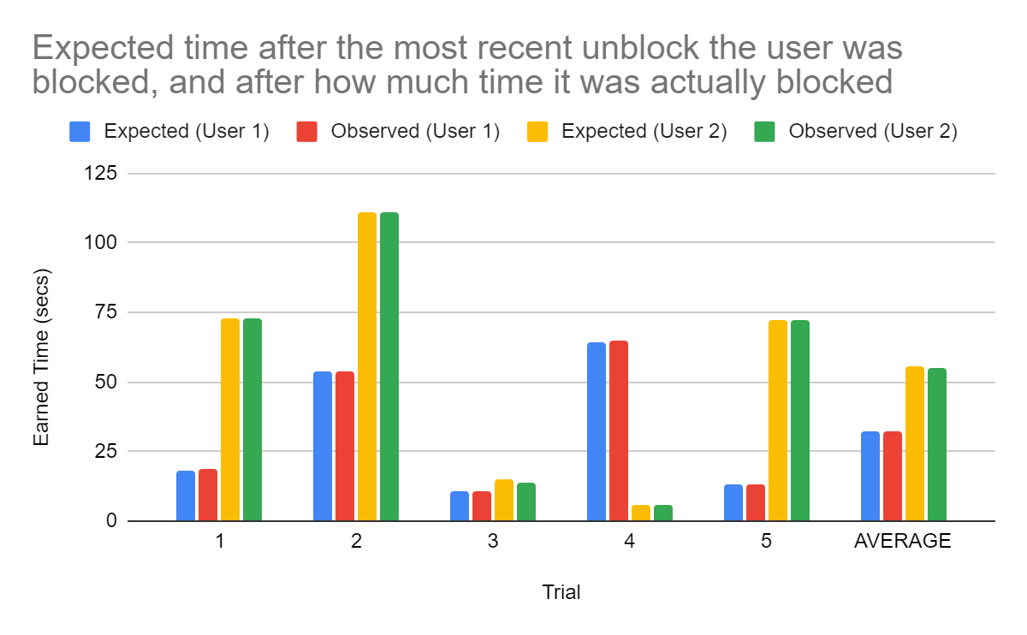
Retest Results
The second round of testing was successful for all of the success criteria 100% of the time.
Criteria #1 - The steps recorded by the tracker and the steps observed by the virtual router were the same after the retesting.
Criteria #2 - The expected time until the block and how much time was actually there until the block were the same after the retesting.
Notes:
20 seconds (25)

Slide 10
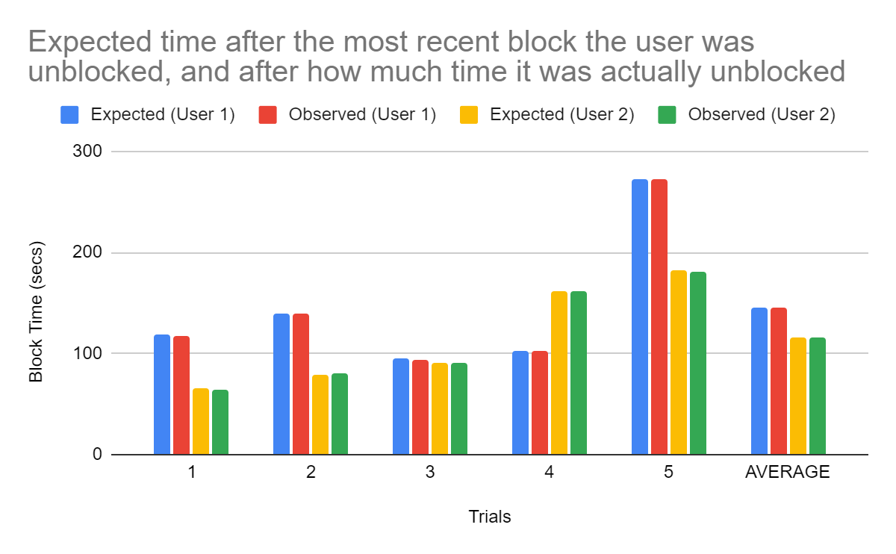
Retest Results
The second round of testing was successful for all of the success criteria 100% of the time.
Criteria #3 - The expected time until the unblock and how much time was actually there until the unblock were the same after retesting.
Notes:
20 seconds (25)

Slide 11
Conclusion
Initially, the results were not as expected, but after fixing the database issue, all of the tests passed 100% of the time.
The proposed solution is autonomous, and can be used by people of all ages, without any technical background. Current solutions rely on personal motivation, and can be easily bypassed without any consequence, and therefore are not very effective. My solution is better, since it manages a user’s internet connectivity, which is something that people need in their daily lives - especially during the pandemic, based on physical activity.
In the future, I would make the countdown until the user’s internet access is blocked based on how much screen time the user actually uses, instead of just counting down from when the user logs activity data. I would also make the system more user friendly, by creating an easier way to “add” devices to the list of devices to block and unblock - currently, to add devices, a user has to edit the actual script being run on the virtual router.
Notes:
20 seconds (25)

Slide 12
References
“Fitbit Development: Application Design.” Fitbit, Viewed September 26, 2021. https://dev.fitbit.com/build/reference/web-api/developer-guide/application-design/.
“Fitbit Development: Getting Started.” Fitbit, Viewed September 26, 2021. https://dev.fitbit.com/getting-started/#.
“Lack of Physical Activity.” Centers for Disease Control and Prevention, Centers for Disease Control and Prevention, 25 Sept. 2019, Viewed September 25th, 2021. https://www.cdc.gov/chronicdisease/resources/publications/factsheets/physical-activity.htm#.
“Video Game Demographics - 27 Powerful Stats for 2021.” TechJury, 9 Sept. 2021, Viewed September 25th, 2021. https://techjury.net/blog/video-game-demographics/.
“Top 10 Parental Control Apps of 2021.” Top 10 Parental Control Apps of 2021, 10 Apr. 2018, Viewed September 26, 2021. https://www.consumersadvocate.org/parental-control-apps/a/best-parental-control-apps?pd=true&keyword=app+that+tracks+screen+time&bca_campaignid=333739434&bca_adgroupid=1207264130537424&bca_matchtype=e&bca_network=o&bca_device=c&msclkid=7436c5f7f8301a59d944a4a742550e5d.
Notes:
20 seconds (25)

